Slide 1
Software Life Cycle Models
COMP 3700: Modeling and Design
Thursday, January 19, 2017
Gomaa, 2011; Pettit, 2014; Qi, 2015

Slide 2
In Class: Straw House Activity
Get into groups of 6
Roles
Facilitator
Timekeeper
Scribe
Runner
Client/Customer
Lead Builder
Procedure
Select Team Roles (5 minutes)
Talk with client/customer (5 minutes)
Build (15 minutes)
Assess client/customer satisfaction (5 minutes)
SEE FULL SET OF INSTRUCTIONS IN CANVAS AND ON IN-CLASS HANDOUT

Slide 3
Life-Cycle Model
Specifies the various phases/workflows of the software process including:
requirements,
analysis (specification),
design,
implementation, and
Post-delivery maintenance
Also specifies the order in which they are to be carried out.

Slide 4
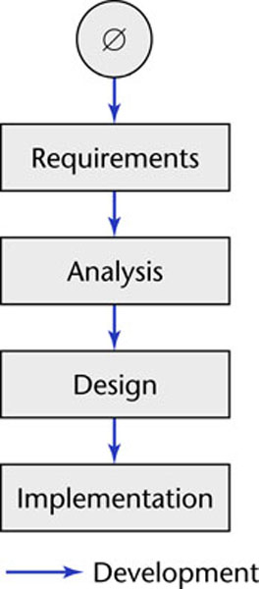
Software Development in Theory
Ideally, software is developed in a linear fashion from scratch

Slide 5
Software Development in Practice
In the real world, software development is totally different and is more chaotic
Software professionals make mistakes
The client’s requirements change while the software product is being developed
A software product is a model of the real world, and the real world is continually changing.

Slide 6
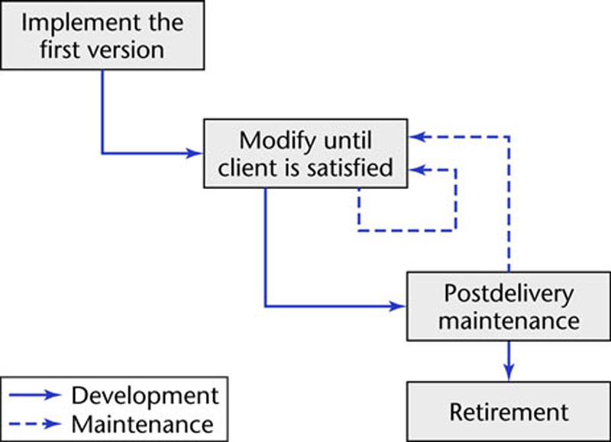
Code-and-Fix Life-Cycle Model
The easiest way to develop software
No design
No specifications
The most expensive approach for maintenance
The product is implemented without requirements or specifications, or any attempt at design.
The developers simply throw code together and rework it as many times as necessary to satisfy the client.
Used in small projects
Completely unsatisfactory for products of any reasonable size
Notes:
The easiest way to develop software
The most expensive way

Slide 7
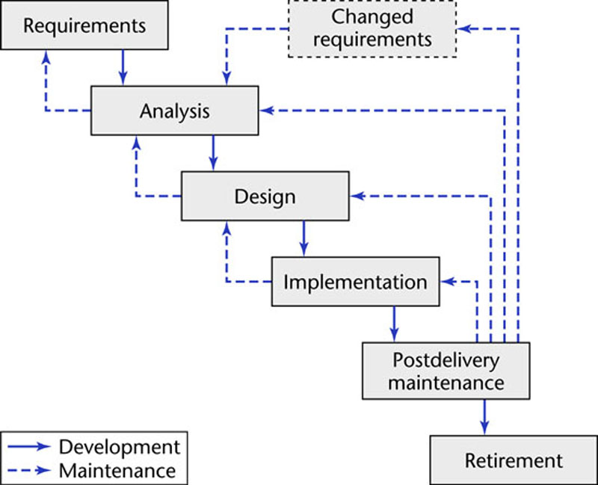
Waterfall Life-Cycle Model
Linear model with feedback loops
No phase is complete until
documentation for that phase has been completed
products of that phase have been approved by the software quality assurance (SQA) group.
If the products of an earlier phase have to be changed as a consequence of following a feedback loop, that earlier phase is deemed to be complete only when the documentation for the phase has been modified and the modifications have been checked by the SQA group.

Slide 8
Waterfall Life-Cycle Model
Advantages:
Documentation is provided at each phase
All the products of each phase (including the documentation) are meticulously checked by SQA
Maintenance is easier
Disadvantages:
Specification documents are long and detailed
Dry reading

Slide 9
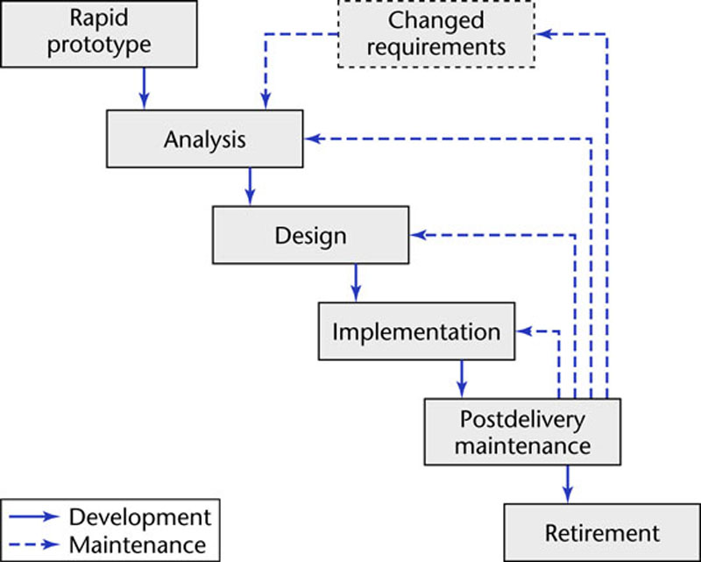
Rapid-Prototyping Life-Cycle Model
Linear model
A rapid prototype a model that is functional and represents a subset of the product
Build a rapid prototype and let the client and future users interact and experiment with the rapid prototype.

Slide 10
Rapid-Prototyping Life-Cycle Model (Cont.)
Strengths:
The development of the product is essentially linear, proceeding from the rapid prototype to the delivered product
The feedback loops of the waterfall model are less likely to be needed in the rapid prototyping model
It is built rapidly and modified rapidly to reflect the client’s needs.
Speed is of the essence.
Weakness:
One the client’s real needs have been determined, the rapid prototype implementation is discarded.
The lessons learned from the rapid prototype implementation are retained and used in subsequent development phases.

Slide 11
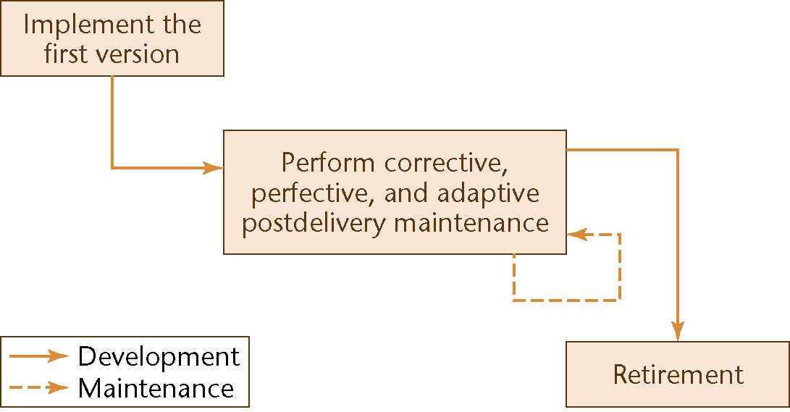
Open-Source Life-Cycle Model
Post-delivery maintenance life cycle model
The first informal phase
One individual builds an initial version and makes it available via the Internet
If there is sufficient interest in the project, the initial version is widely downloaded; users become co-developers; and the product is extended
Individuals generally work voluntarily on an open-source project in their spare time

Slide 12
Open-Source Life-Cycle Model
The second Informal Phase
Reporting and correcting defects
Corrective maintenance
Adding additional functionality
Perfective maintenance
Porting the program to a new environment
Adaptive maintenance
The second informal phase consists solely of post-delivery maintenance

Slide 13
Iterative and Incremental Life-Cycle Model: Incrementation
Miller’s Law: At any one time, we can concentrate on only approximately seven chunks (units of information)
To handle larger amounts of information, use stepwise refinement
Concentrate on the aspects that are currently the most important
Postpone aspects that are currently less critical
Every aspect is eventually handled, but in the order of current importance
This is an incremental process

Slide 14
Iterative and Incremental Life-Cycle Model: Iteration
In the real life, we cannot speak about “the analysis phase”
Instead, the operations of the analysis phase are spread out over the life cycle as a consequence of both the moving target problem and the need to correct the inevitable mistakes
Moving target problem: the requirements change while the software product is being developed. This change is inevitable
The basic software development process is iterative
Each successive version is intended to be closer to its target than its predecessor

Slide 15
Iterative-and-Incremental Model
Strengths
There are multiple opportunities for checking that the software product is correct
Every iteration incorporates the test workflow
Faults can be detected and corrected early
The robustness of the architecture can be determined early in the life cycle
Architecture — the various component modules and how they fit together
Robustness — the property of being able to handle extensions and changes without falling apart
We can mitigate (resolve) risks early
Risks are invariably involved in software development and maintenance
We always have a working version of the software product
Variation: Deliver partial versions to smooth the introduction of the new product in the client organization
There is empirical evidence that the life-cycle model works

Slide 16
Managing Iteration and Incrementation
The iterative-and-incremental life-cycle model is as regimented as the waterfall model since developing a software product using the iterative-and-incremental model is equivalent to developing a series of smaller software products, all using the waterfall model
The project as a whole is broken up into a series of waterfall mini projects.
During each mini-project, iteration is performed as needed.
For each increment, the requirements, analysis, design, and implementation phases are repeatedly performed until it is clear that no further iteration is needed. That is: each increment is a waterfall mini project.
The iterative-and-incremental life-cycle model is the waterfall model, applied successively

Slide 17
Agile Processes: Extreme Programming (Cont.)
Based on the features (stories/scenarios) the client wants:
The development team estimates the duration and cost of each feature
The client selects the features for next build using cost-benefit analysis
The proposed build is broken down into smaller pieces termed tasks
The programmer draws up test cases for a task → Test-driven development (TDD)
Pair Programming: The programmer works together with a partner on one screen to implement the task and ensure that all the test cases work correctly.
Continuous integration of tasks since a number of pairs implement tasks in parallel
The TDD test cases used for the task are retained and utilized in all further integration testing.

Slide 18
Unusual Features of Extreme Programming (XP)
The computers of the XP team are put in the center of a large room lined with cubicles.
A client representative works with the XP team at all times.
Software professionals cannot work overtime for 2 successive weeks.
There is no specialization. Instead, all members of the XP team work on analysis, design, code, and testing.
There is no overall design step before the various builds are constructed. Instead, the design is modified while the product is being built. This procedure is termed refactoring.

Slide 19
Agile Processes
Extreme programming is one of a number of new paradigms that are collectively referred to as agile processes.
Agile processes are characterized by
Less emphasis on analysis and design
Earlier implementation (working software is considered more important than detailed documentation)
Responsiveness to change in requirements
Close collaboration with the client

Slide 20
Agile Processes
A principle in the Manifesto is
Deliver working software frequently
Ideally every 2 or 3 weeks
One way of achieving this is to use timeboxing
Used for many years as a time-management technique
A specific amount of time is set aside for a task
Typically 3 weeks for each iteration
The team members then do the best job they can during that time
Agile processes demand fixed time, not fixed features

Slide 21
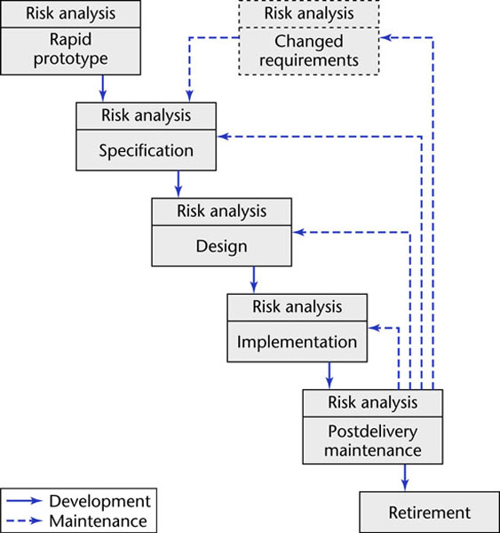
Spiral Life-Cycle Model
Minimize risk via the use of prototypes and other means.
Two types of risk
Analyzable Risk
Time and cost
Un-analyzable Risk
Personnel turnover
Difference between small-scale and large-scale software
Evaluate the delivery promises of a hardware supplier
Simplified form
Rapid prototyping model pus risk analysis preceding each phase
If all risks cannot be mitigated, the project is immediately terminated

Slide 22
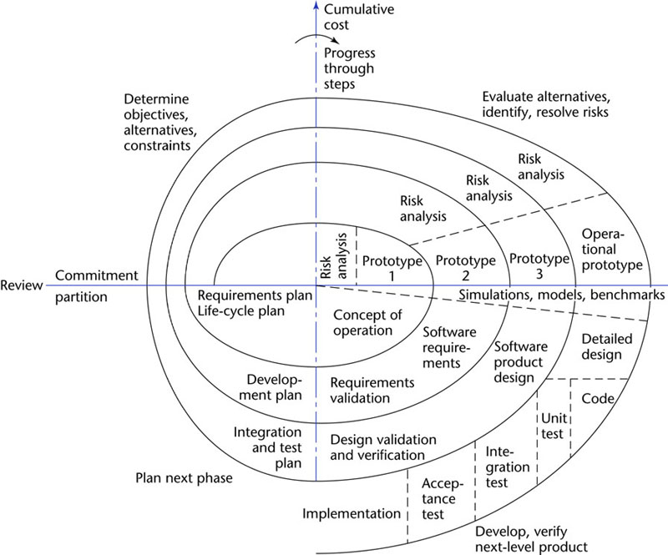
Full Spiral Life-Cycle Model
Full form
Precede each phase by
Alternatives
Risk analysis
Determining
Objective of the phase
Alternatives for achieving the objectives
Constraints imposed on those alternatives
Follow each phase by
Evaluation
Planning of the next phase
Radial dimension – cumulative costs to date
Angular dimension: progress through the spiral

Slide 23
Spiral Life-Cycle Model
Strengths
The emphasis on alternatives and constraints supports the reuse of existing software and the incorporation of software quality as a specific objective
There is essentially no distinction between development and maintenance since maintenance is another cycle of the spiral
Weaknesses
For large-scale software only
For internal (in-house) software only

Slide 24
Whichever software life cycle is adopted…
You must carry out the following activities:
Requirements Analysis & Specification
User requirements are identified and analyzed
Architectural Design
System is structured into its constituent components and the interfaces between these components are defined
Detailed Design
Algorithmic details of each system component are defined
Coding/Implementation
Unit Testing
Testing of individual components before they are combined with other components
Integration Testing
Combining tested components into progressively more complex groupings and testing those groupings until the whole software system has been put together and the interfaces tested
System testing
Testing an integrated hardware and software system to verify that the system meets its specified requirements

Slide 25
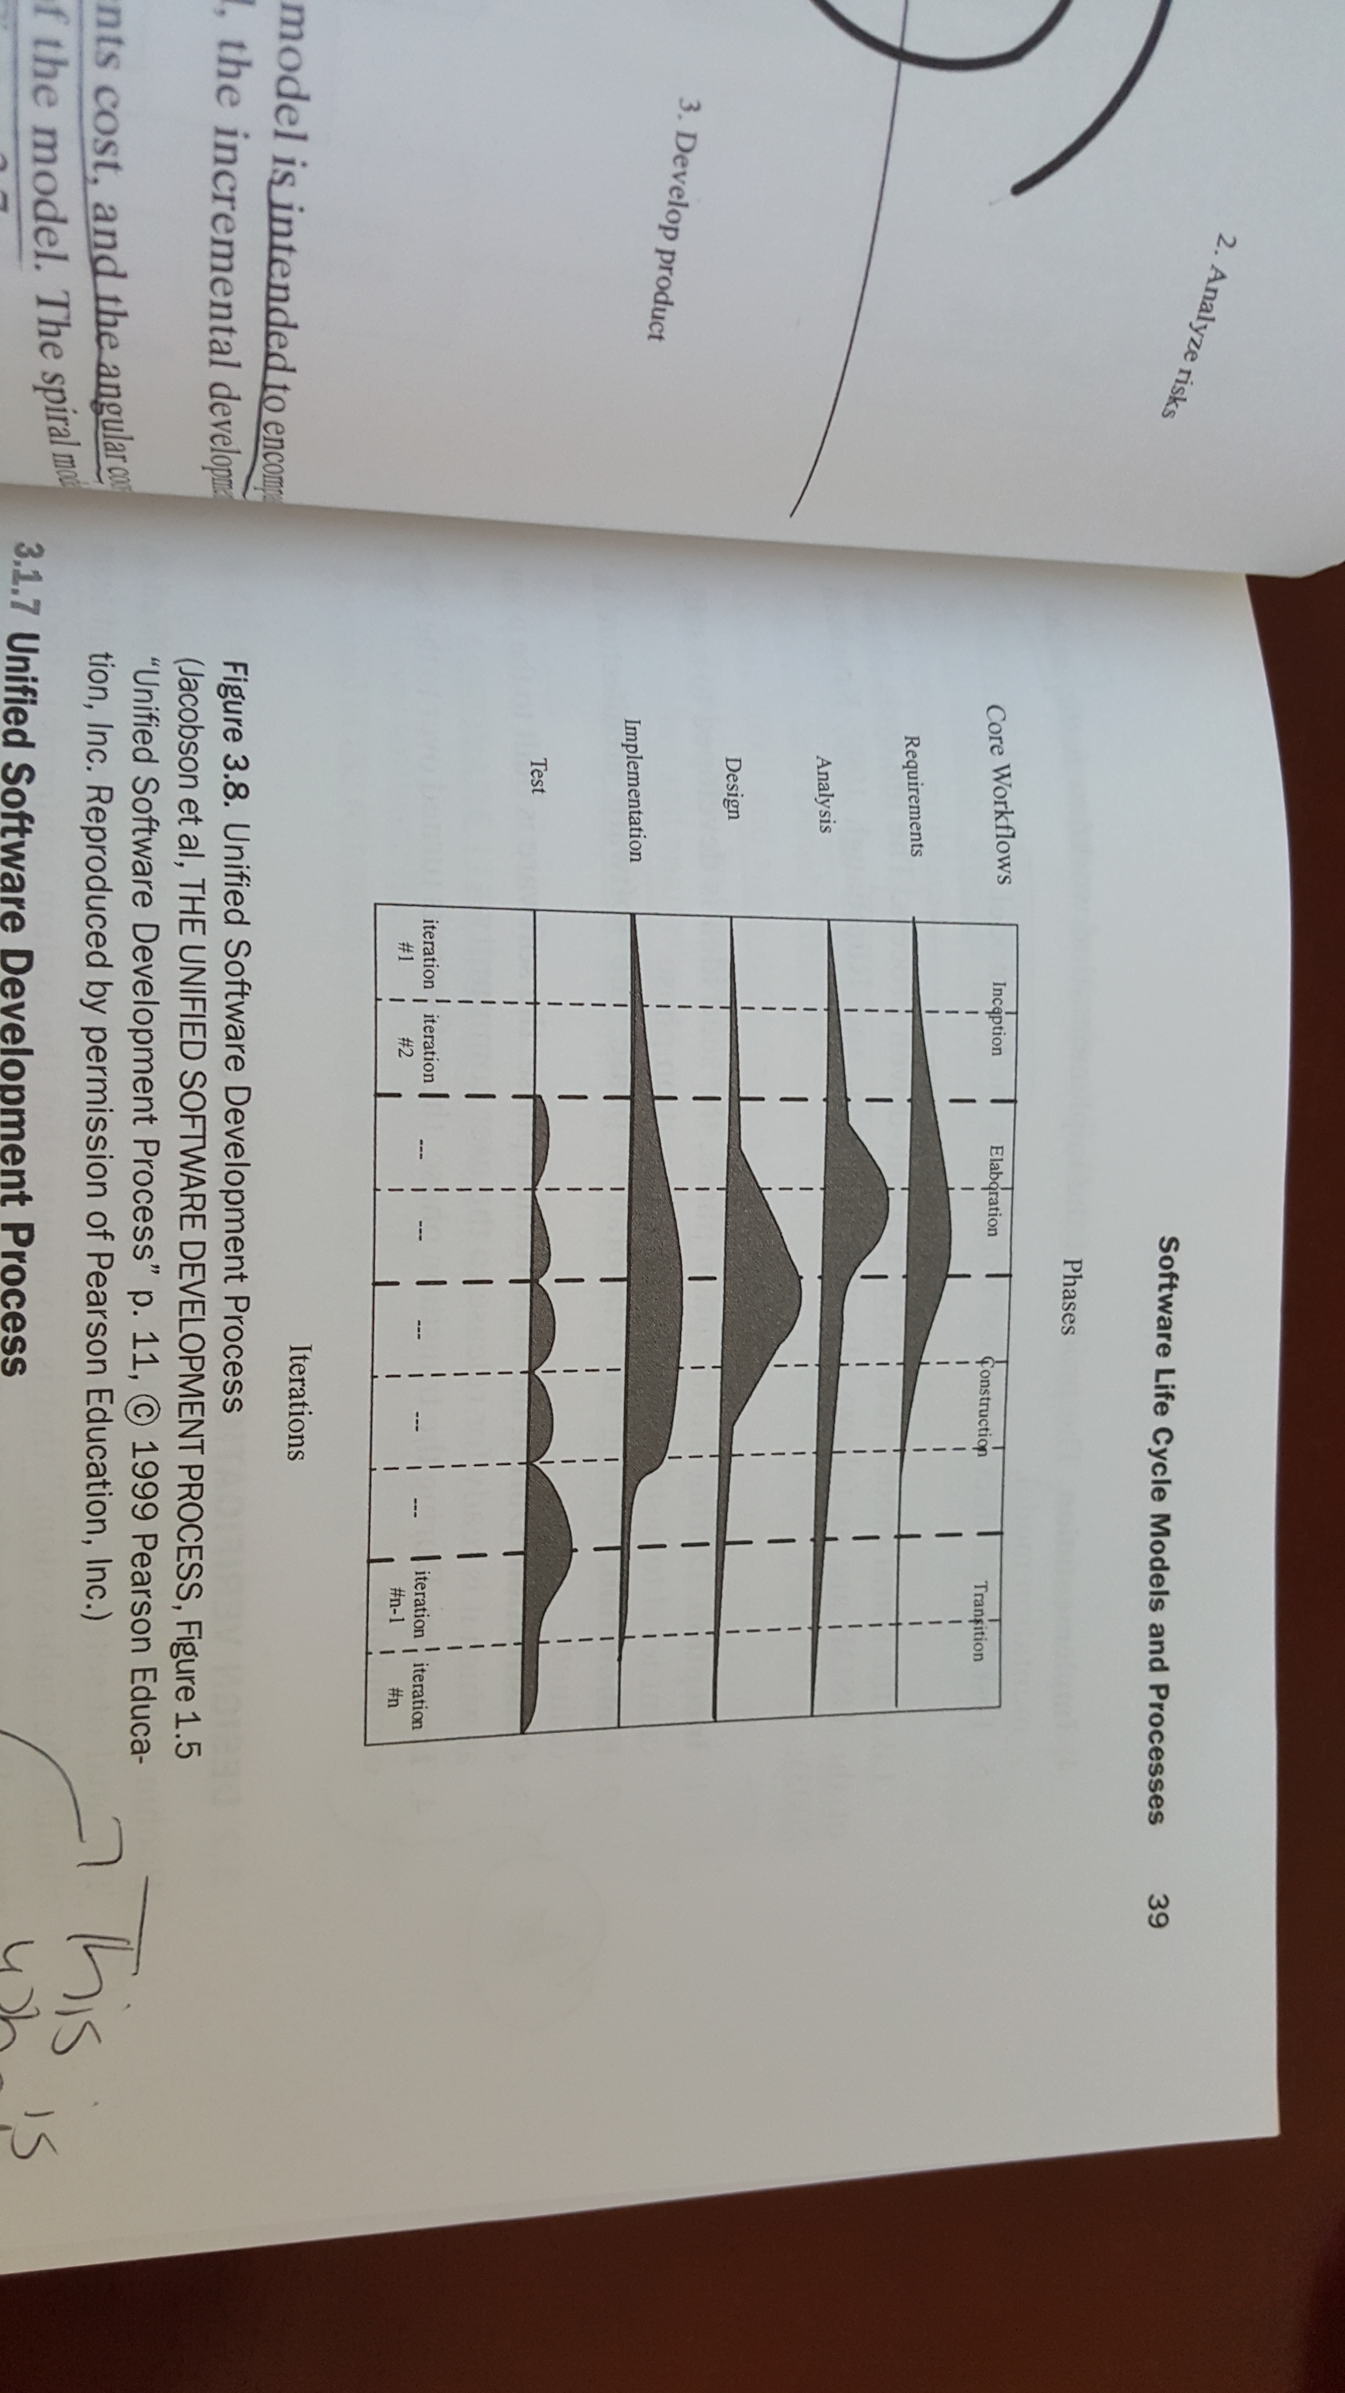
Unified Software Development Process
Use case-driven software process that uses the UML notation
AKA Rational Unified Process (RUP)
Risk-driven approach
Consists of 5 core workflows and four phases
Workflow – sequence of activities that produces a result of observable value
Phase – the time between two major milestones during which
A well defined set of objectives is met
Artifacts are completed
Decisions about whether to move on to the next phase are made
Iterative
Each cycle goes through all four phases and addresses the development of a core workflow

Slide 26
Unified Software Development Process
USDP/RUP life cycle workflows
Requirements
Product: Use case model
Analysis
Product: Analysis model
Design
Products: Design model & Deployment model
Implementation
Product: Implementation model
Test
Product: Test model
USDP/RUP life cycle phases
Inception – Seed idea is developed to a sufficient level to justify entering the elaboration phase
Elaboration – Software architecture is defined
Construction – Software is built to the point at which is is ready for release to users
Transition – Software is turned over to user community

